Slide 1
COMP 3500 Introduction to Operating Systems Directory Structures
Block Management
Dr. Xiao Qin
Auburn University http://www.eng.auburn.edu/~xqin
xqin@auburn.edu
Slides are adopted and modified from materials developed by Drs. Stallings and Nutt
Notes:
25 Minutes.
Focus on the idea of LRU.
Clock policy was not covered.

Slide 2
File Descriptors
External name
Current state
Sharable
Owner
User
Locks
Protection settings
Length
Time of creation
Time of last modification
Time of last access
Reference count
Storage device details
How to design a file control block (a.k.a., file descriptor)?
From “File Systems Requirements” to “File Attributes”
From “File Attributes” to “a File Control Block”
Notes:
Reference: http://pages.cs.wisc.edu/~bart/537/lecturenotes/figures/demos-fs.gif

Slide 3
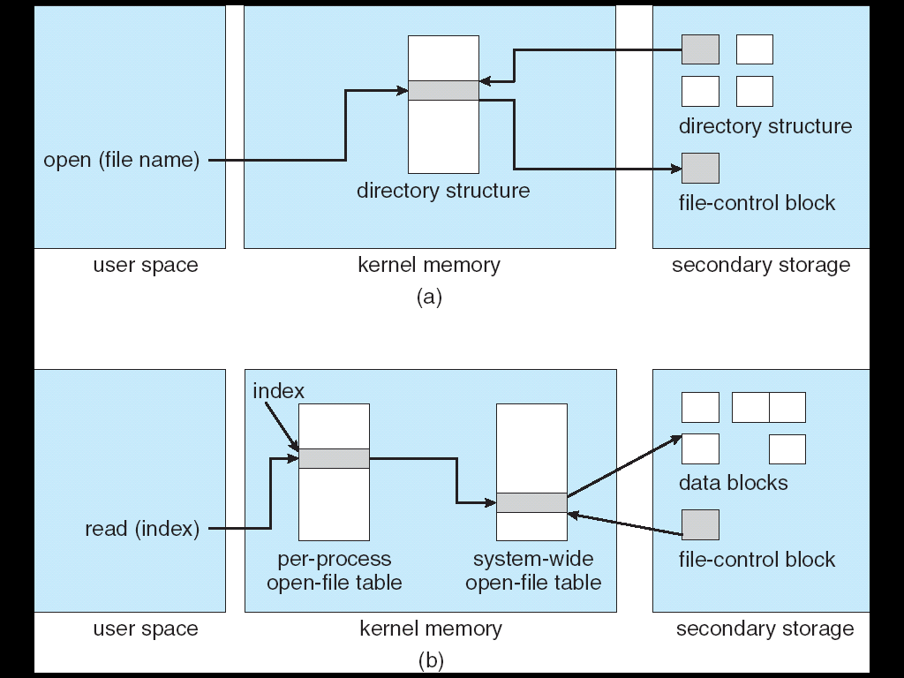
In-Memory File System Structures

Slide 4
An open() Operation
Locate the on-device (external) file descriptor
Extract info needed to read/write file
Authenticate that process can access the file
Create an internal file descriptor in primary memory (“System-wide”)
Create an entry in a “per process” open file status table
Allocate resources, e.g., buffers, to support file usage

Slide 5
File Manager Data Structures
2
Keep the state of the process-file session
1
Copy info from external to the open file descriptor
Open File
Descriptor
3
Return a reference to the data structure
Process-File
Session
External File Descriptor

Slide 6
Virtual File Systems
Virtual File Systems (VFS) provide an object-oriented way of implementing file systems.
VFS allows the same system call interface (the API) to be used for different types of file systems.
The API is to the VFS interface, rather than any specific type of file system.

Slide 7
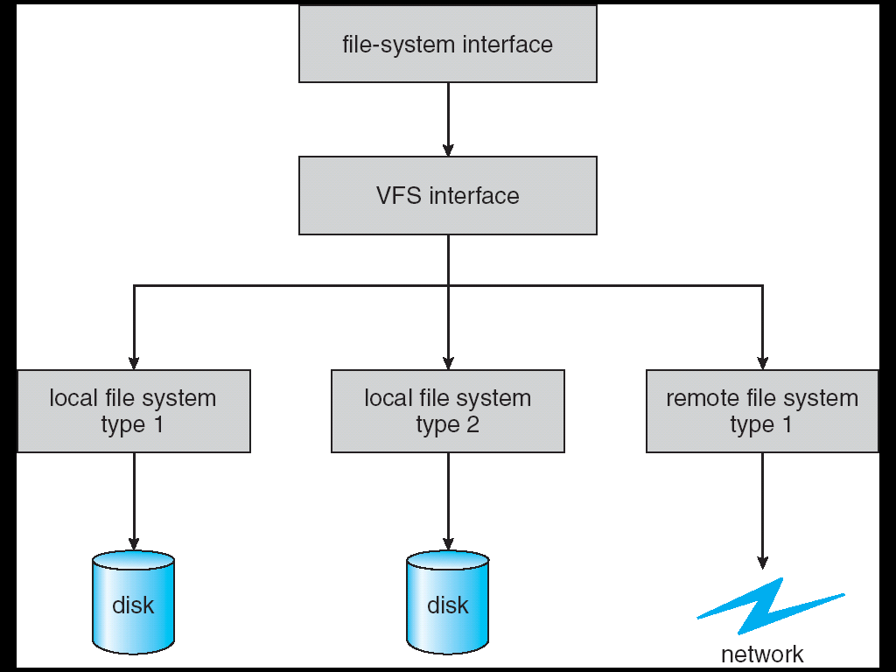
Schematic View of a Virtual File System

Slide 8
Directory Structure
A collection of nodes containing information about all files
Directory
Files
F 1
F 2
F 3
F 4
F n
Both the directory structure and the files reside on disk
Backups of these two structures are kept on storage systems

Slide 9
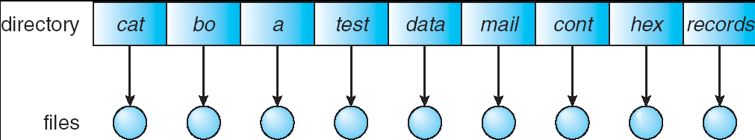
Single-Level Directory
A single directory for all users
Good News? Problems?
Naming problem
Grouping problem

Slide 10
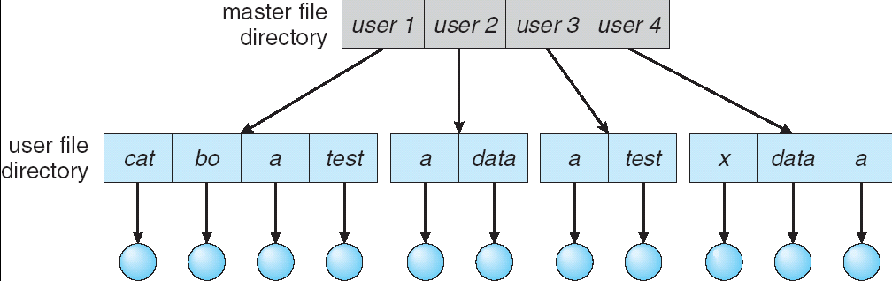
Two-Level Directory
Separate directory for each user
Advantages? Problems?
Path name
Can have the same file name for different user
Efficient searching
No grouping capability

Slide 11
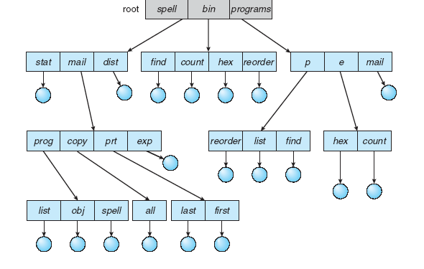
Tree-Structured Directories
Notes:
Efficient searching
Grouping Capability
Current directory (working directory)
cd /spell/mail/prog
type list

Slide 12
Block Management
The job of selecting & assigning storage blocks to the file
For a fixed sized file of k blocks
File of length m requires N = ⎡m/k⎤ blocks
Byte b_{i} is stored in block ⎣i/k⎦
Three basic strategies:
Contiguous allocation
Linked lists
Indexed allocation

Slide 13
Contiguous Allocation
Maps the N blocks into N contiguous blocks on the secondary storage device
Difficult to support dynamic file sizes
File descriptor
Head position 237
…
First block 785
Number of blocks 25

Slide 14
Linked Lists
Each block contains a header with
Number of bytes in the block
Pointer to next block
Blocks need not be contiguous
Files can expand and contract
Seeks can be slow
First block
…
Head: 417
...
Length
Length
Length
Byte 0
Byte 0
Byte 0
...
...
...
Byte 4095
Byte 4095
Byte 4095
Block 0
Block 1
Block N-1

Slide 15
Indexed Allocation
Extract headers and put them in an index
Simplify seeks
May link indices together (for large files)
Byte 0
...
Index block
…
Head: 417
...
Byte 4095
Length
Block 0
Byte 0
Length
...
Byte 4095
Byte 0
Block 1
...
Length
Byte 4095
Block N-1

Slide 16
inode
UNIX Files
mode
owner
…
Direct block 0
Direct block 1
…
Direct block 11
Single indirect
Double indirect
Triple indirect
Data
Data
Data
Index
Data
Index
Data
Index
Index
Index
Data
Index
Data
Index
Index
Data
Index
Data

Slide 17
Unallocated Blocks
How should unallocated blocks be managed?
Need a data structure to keep track of them
Linked list
Very large
Hard to manage spatial locality
Block status map (“disk map”)
Bit per block
Easy to identify nearby free blocks
Useful for disk recovery

Slide 18
Summary
Directory Structures
Single-Level Directory
Two-Level Directory
Tree-Structured Directory
Block Management
Contiguous Allocation
Linked Lists
Indexed Allocation

